Slide 1

Introduction to Redux
Bishal Pantha
@panalbish
Bonn Agile Meetup
21.03.2017

Slide 2
React way: pass props
Use setState API from React
Pass props to child components
Many child components just pass the props to their successive child and so on..
Can be easily messy and difficult to understand the flow of data

Slide 3
Context
Pass data down to entire subtree
Only send down the tree not from subtree to parent
Undocumented and experimental

Slide 4
Redux
Open source client side state management lib
Describe UI as a function of a state
Inspired by Flux and Elm
No relation to react

Slide 5
setState
Start here
NOT an anti-pattern
Learn React lifecycle methods
Learn (internal) component state management
State is hierarchical and matches component structure

Slide 6
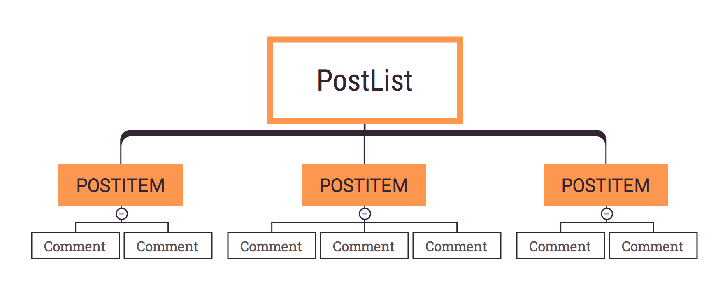
setState
App

Slide 7
What’s the Problem

Slide 8
Problem
Share more state across multiple components
Distant leaf components need access to state

Slide 9

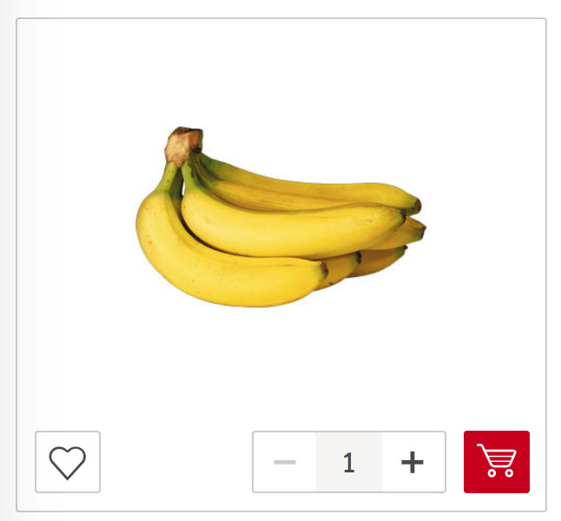
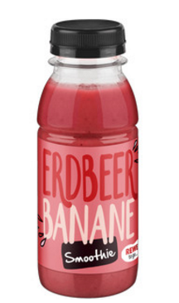
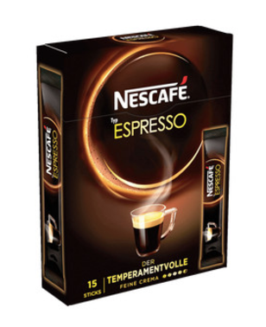




Slide 10
Redux in Picture
Flux
Redux
A
Dispatcher
A
A
Actions
Store - {}
A
Reducer
Actions
Store
1
Store
1
Store
1
R
R
R
View
View
connect()
* Ref: Preethi Kasireddy - MobX vs Redux: Comparing the Opposing Paradigms - React Conf 2017

Slide 11
Redux Terms
State
Store
Container
Action Creator
Action
Reducer

Slide 12
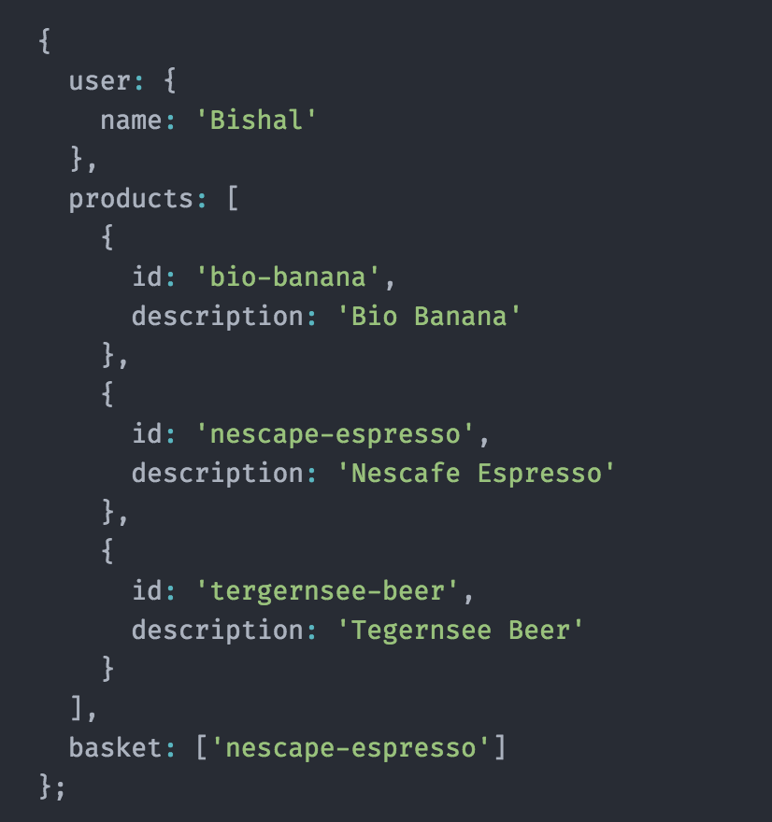
State:
single source of truth
- JavaScript Object
- Maintains all the application
State

Slide 13

Store:
Protector of the state
Middleware between UI and
state
Ref: https://onsizzle.com/i/affles-the-cat-lord-waffles-waffleston-of-house-waffles-first-4876681

Slide 14
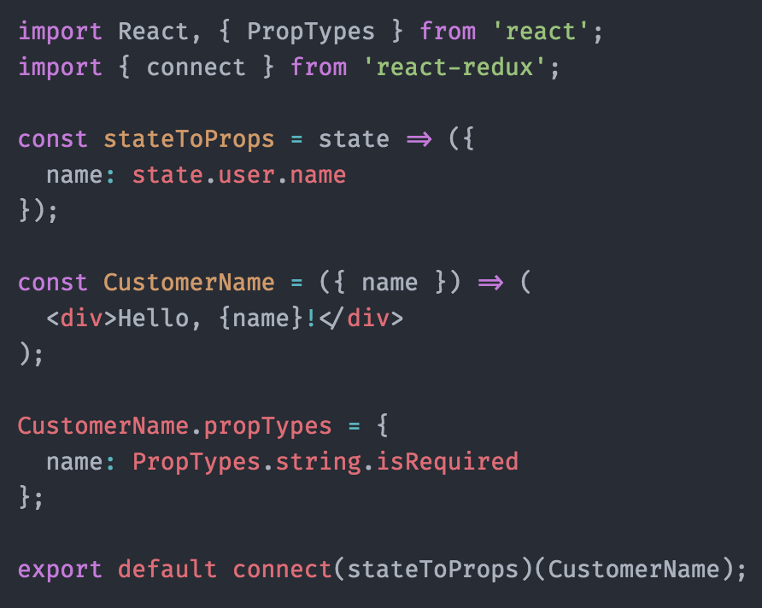
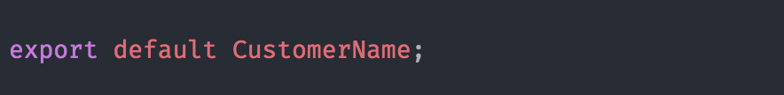
Container: stateToProps
Provide Stateless component the data they need
Multiple container components can use the same part of the state without being the child of same parent

Slide 15
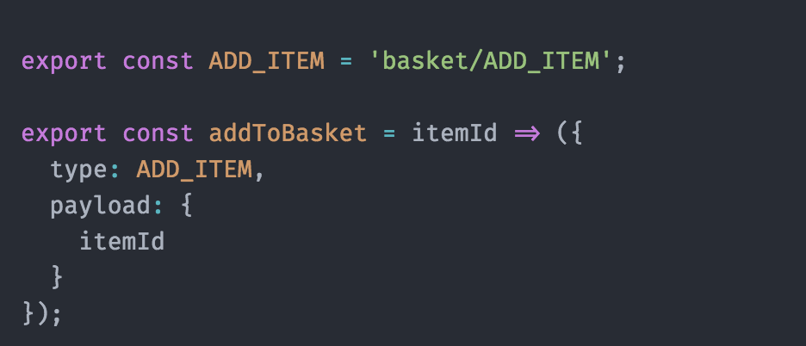
Action Creators
Create actions based on the type
Optional payload data

Slide 16
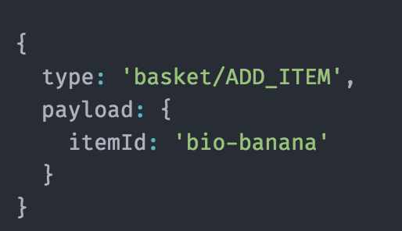
Action
Result of Action Creator
Plain JavaScript Object
Only source of information from views to change the state
Can be as simple as {type:’INCREMENT’}

Slide 17
Reducer
Changes are made with Pure functions
Don’t depend and do not modify the state of variables outside of its scope
Always return same result give the same arguments
Update the state based on action

Slide 18
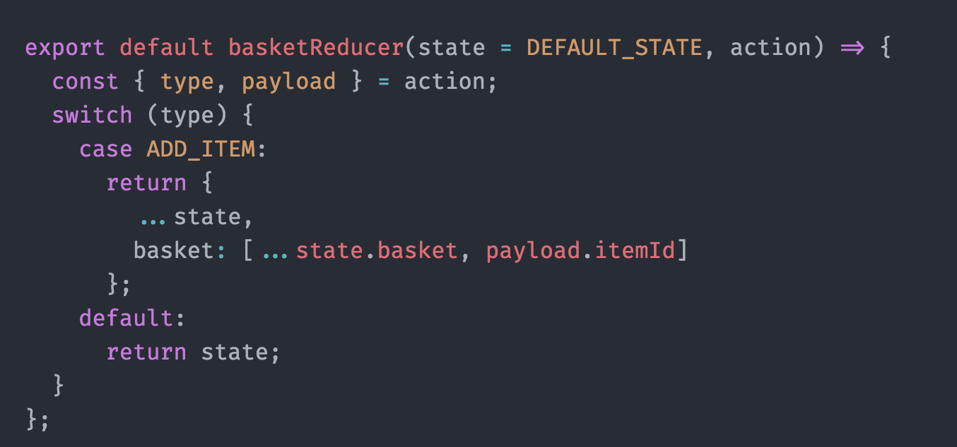
Immutable: Always returns the new state object
state.basket = [...state.basket, payload.itemId];
return state;

Slide 19
Container: dispatchToProps
Map the actions to components
bindActionCreators helper method from redux

Slide 20
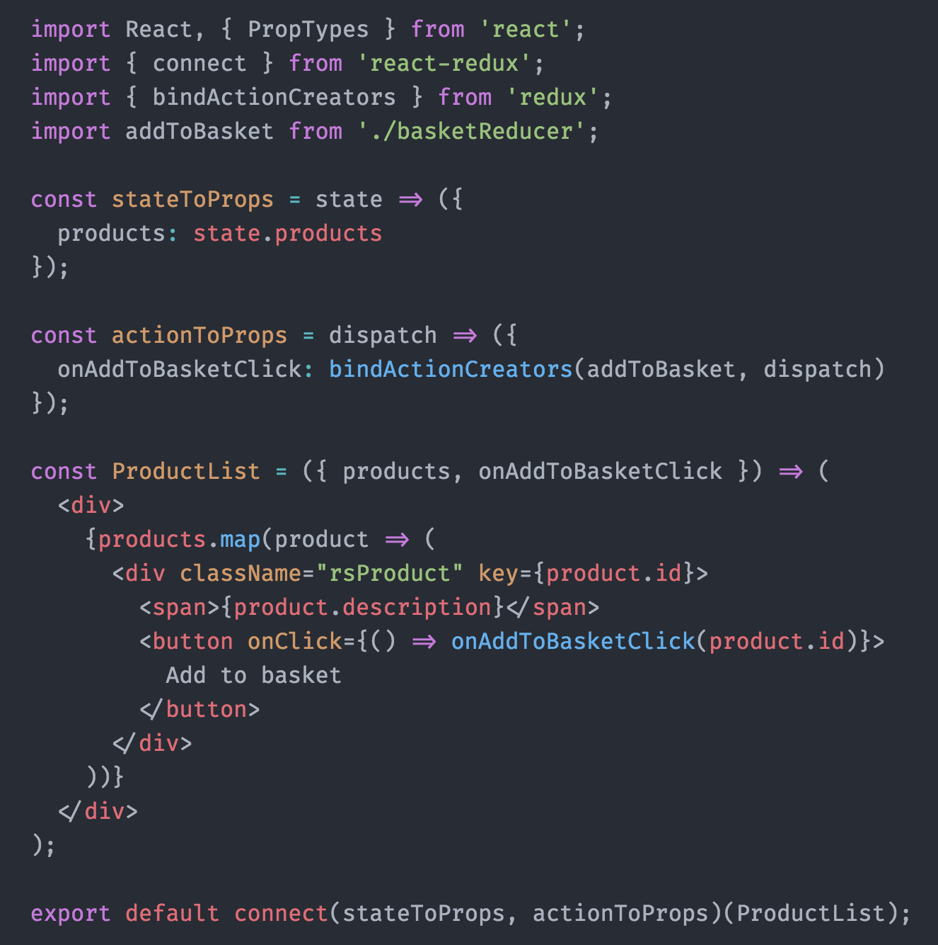

Slide 21
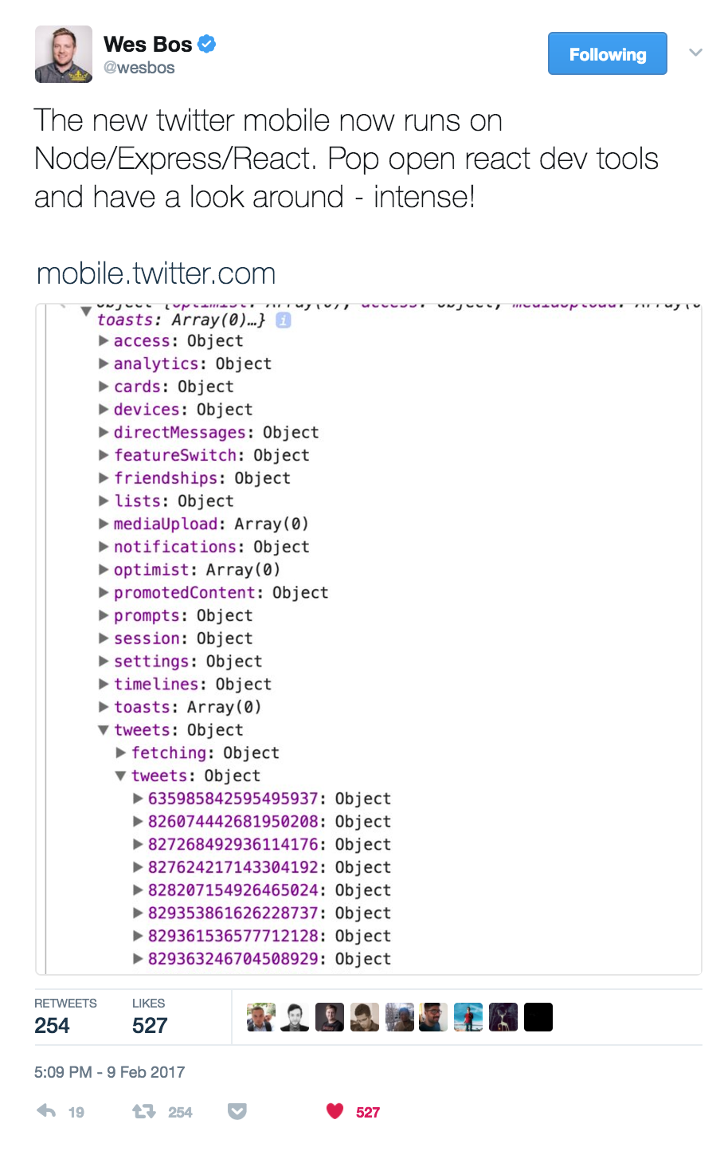
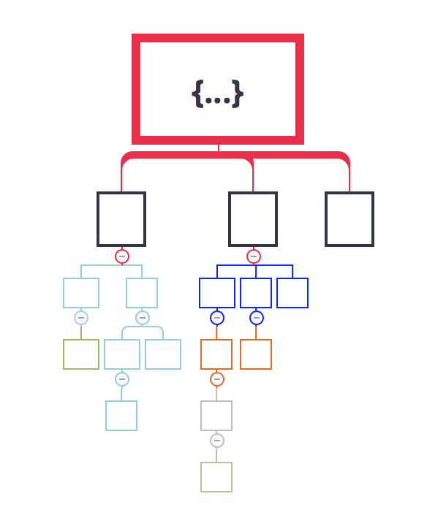
But most applications
need complex state

Slide 22
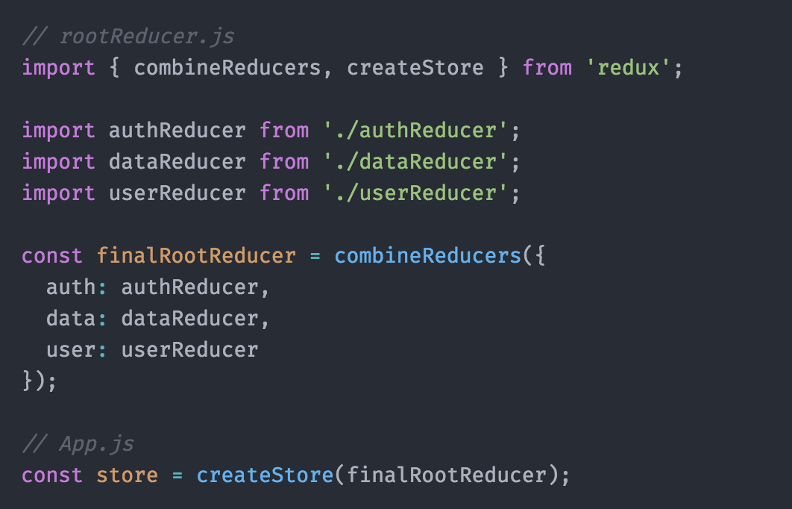
Multiple Reducers
combineReducers API
can contain multiple hierarchical reducers

Slide 23


Slide 24
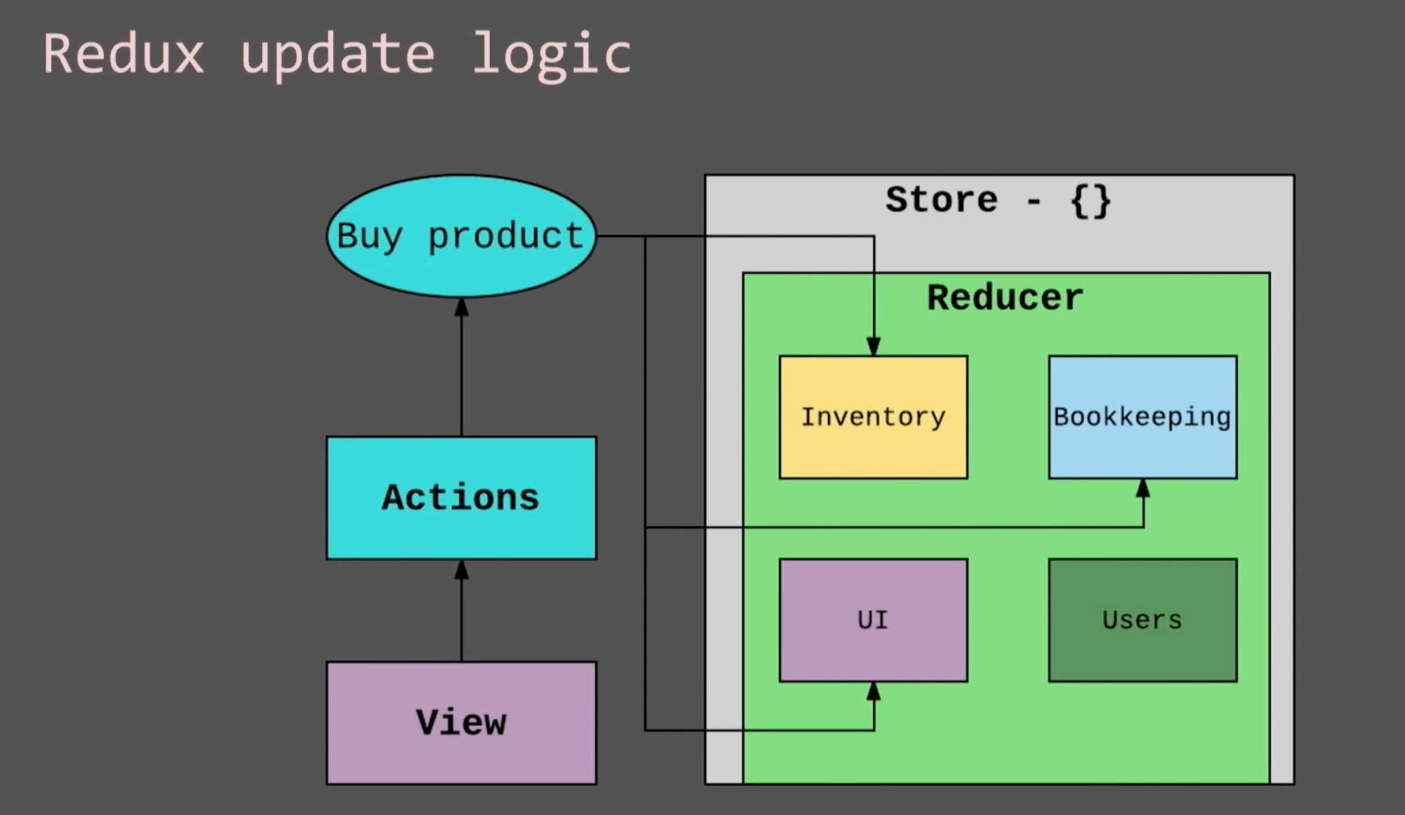
Update Logic
more than one part of state is affected by an action

Slide 25
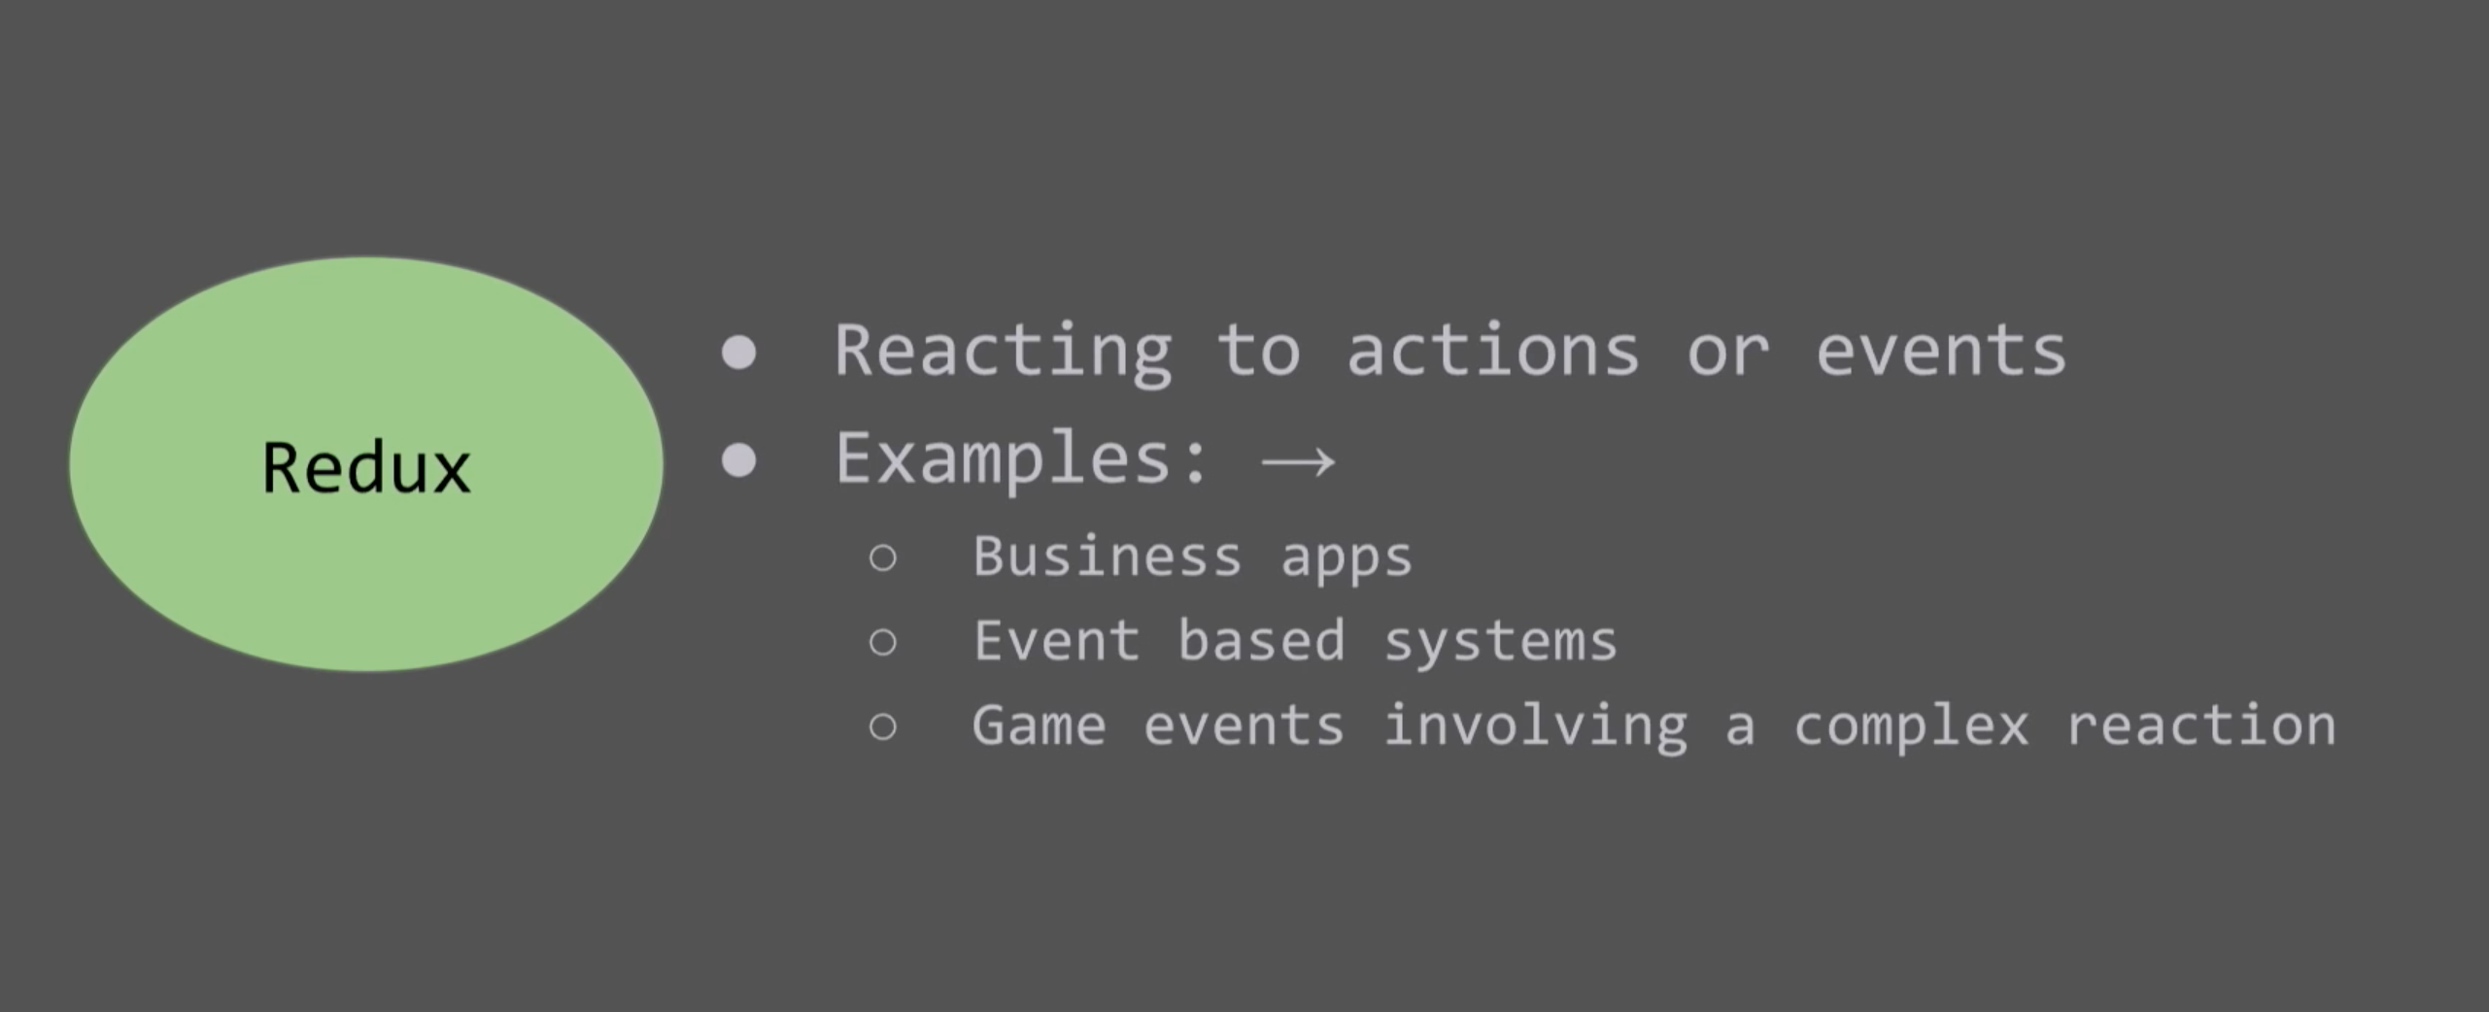
Redux shines
best used for

Slide 26
Selling Points
Referential Transparency
Pure reducer functions
Immutable state
Predictability
Testing
SSR
Community and Eco-system

Slide 27
Code and Slides
https://github.com/panalbish/redux-react-intro

Slide 28
Thanks

